Slide 1


REAL TIME FACE MASK DETECTION
PANIMALAR ENGINEERING COLLEGE
DEPARTMENT OF COMPUTER SCIENCE AND ENGINEERING
CS8811 PROJECT WORK
REVIEW NO:2
Guide Name: M.Rajendiran
Team Members : Mritesh M, Valaparla Akhil Tagore, Vengiswaran AL
Batch No: C10

Slide 2
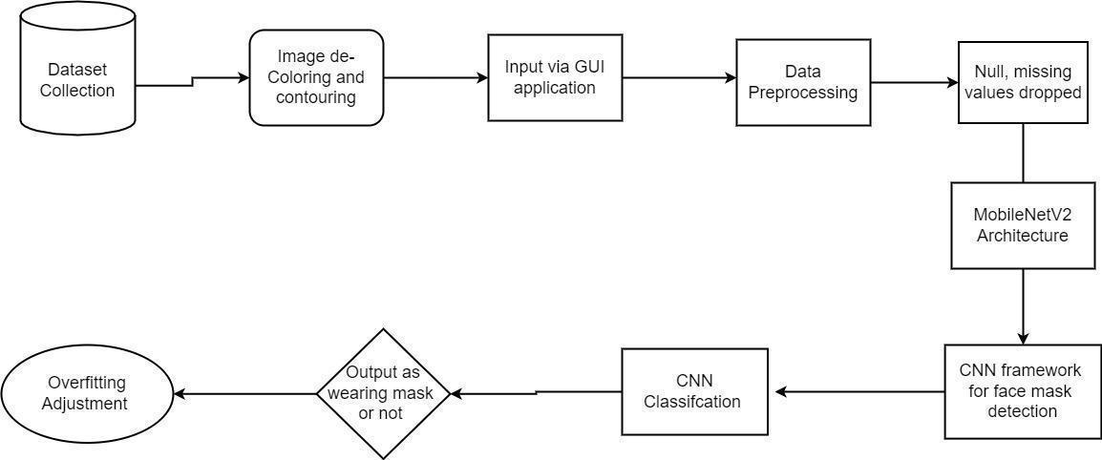
System architecture
This diagram is nothing but a simple description of all the entities that have been incorporated into the system. The diagram represents the relations between each of them and involves a sequence of decision-making processes and steps. You can simply call it a visual or the whole process and its implementation. All functional correspondences are explained in this diagram.

Slide 3
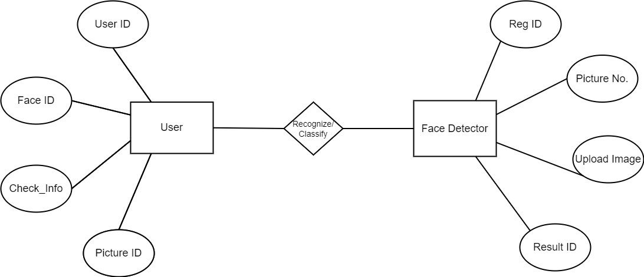
System Design
ER DIAGRAM
ER stands for Entity Relationship. These diagrams display the relationship of entities that are used and stored in the database. They explain the structure of the whole process. these diagrams can be made using three basic concepts, attributed, relationships, and entities.

Slide 4
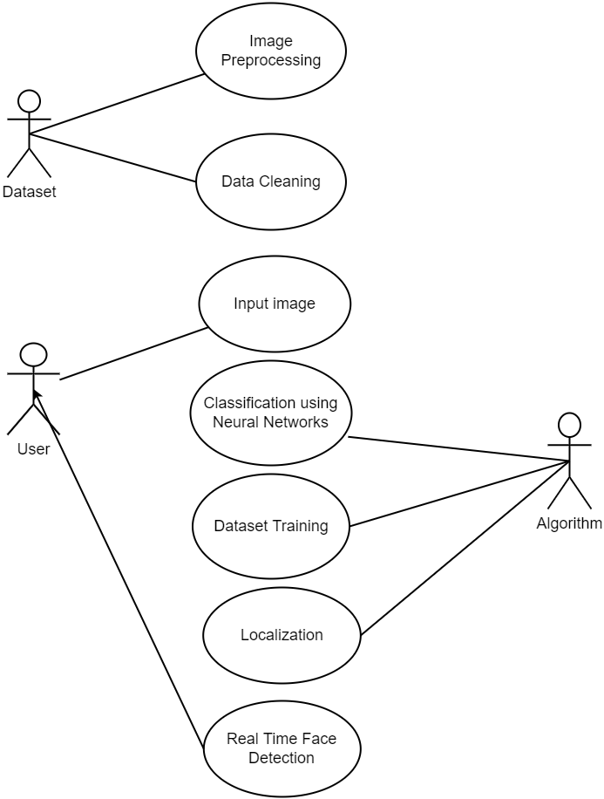
USE-CASE DIAGRAM
A use case diagram is a standard diagram that shows all interactions between the user, dataset, and algorithm used. It is developed in the early stages of the process.

Slide 5
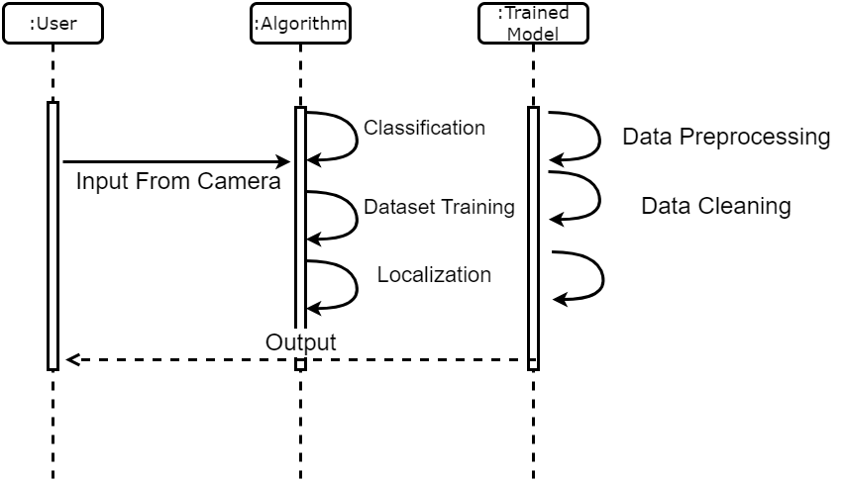
UI DIAGRAM
These are other kinds of interaction-based diagrams that show how all the operations are carried out. They capture the context of collaborations between objects and processes.

Slide 6
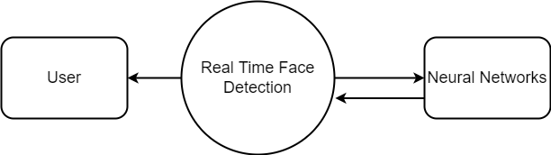
DATABASE LEVEL 0
This is basically a contextual diagram, also referred to as a “context diagram”. It only represents the top level or the 0 Level in the whole process.it gives an abstraction kind of view and shows the whole system as a single process and its relationship to externalities.

Slide 7
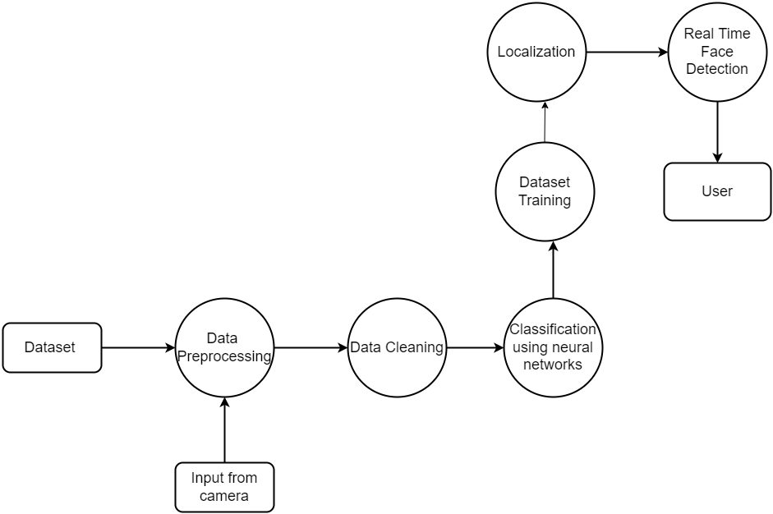
DATABASE LEVEL 1
Level DFDs represent the complete system as a single process. it notates every process and sub-process that comes together in a sequence to form the complete system. This along with ) and 2-level data flow diagrams comprise the “fundamental system model”.

Slide 8
MODULE DESCRIPTION
GUI AND DATA PREPROCESSING
The gathering of datasets for face mask detection was done through continuous image de-colouration and contouring, hence the dataset is very pure. In many cases, the main module is the input module where the data are implemented, in this module the data can be directly added via GUI and through an endpoint connection which can be able to produce the output. The GUI application is built in python. Face mask detection refers to detecting faces in the image and then classifying each face as with a mask or without a mask. The process begins with preprocessing of the given data from a large dataset. The data is cleaned and pre-processed at this stage, where missing and null value records are dropped. In our dataset, we cleaned all the null values and checked whether all the data types are valid. The main purpose of preprocessing is to identify and drop or substitute the missing values in the dataset which occupy a very small part of the whole data, to ensure an accurate result.

Slide 9
MODULE 2: TRAINING NEURAL NETWORKS
MobileNetV2 is an architecture of bottleneck depth separable convolution building of basic blocks with residuals. We propose to use MobileNetV2 architecture to ensure accurate face-mask detection, the proposed CNN architecture. We choose to use MobileNetV2 since it provides several advantages such as:
it is a light-weight DL suited to edge devices,
it provides excellent results for object detection, and
it can efficiently tradeoff between accuracy and latency using simple global hyperparameters.
The most amazing thing about this approach is that it actually works remarkably well. They tend to work best when all the features are at least, well, relevant, because the number of features selected for a particular tree is small.

Slide 10
3 MODULE 3: CLASSIFICATION AND OUTPUT
The MobilenetV2 architecture is used as a foundation for the classifier to perform real-time mask identification. Since MobileNet v2 outperforms other state of art methods in predicting outcomes accurately, it is used efficiently in this model. Then the proposed CNN classifies faces with and without masks as the output layer of the proposed CNN architecture. It saves the best model with the highest accuracy. Finally, the saved model can be used in the real world. The name of this phase is model evaluation. Overfitting when any classification parameter like with mask and without mask needs to be adjusted, it is necessary to have a training dataset apart from training and testing datasets. Web and desktop apps can use the live video feed for detection. The program can also be linked to the entrance gates, allowing only those who are wearing masks to enter. It can also be used in shopping malls and universities.

